Slide 1
Heart Disease Prediction
Team 5
Jieun Lee, Heesun Park, Bosun Kwak, Mercy Kamau

Slide 2
Introduction
Background
Doctors can make different diagnoses of the same patient's disease.
The predictive model can objectively judge diseases.
The Need for Research
To improve the accuracy of medical diagnosis and prescription.
To effectively use the healthcare decision system in terms of reliability.
To save on time and cost.

Slide 3
2. Goal
Early detection of heart disease and prevent mortality among patients
Diagnosis by comparing and analyzing with existing data based on the patient’s clinical information and test information
Assist healthcare professionals and physicians using data
Time and cost efficiency can be increased by minimizing unnecessary inspection

Slide 4
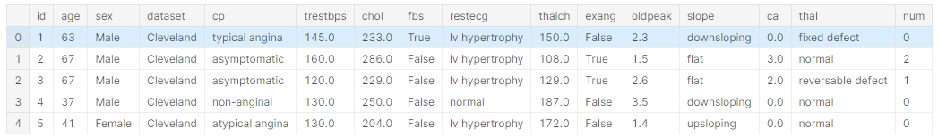
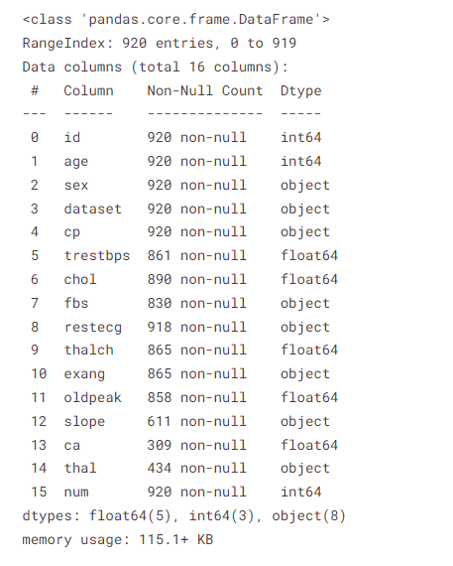
3. Data set
UCI Heart Disease Data : Heart Disease Data Set from UCI data repository (https://www.kaggle.com/datasets/redwankarimsony/heart-disease-data
0
⬝ cp : chest pain type [typical angina, atypical angina, non-anginal, asymptomatic]
⬝ trestbps : resting blood pressure (resting blood pressure (in mm Hg on admission to the hospital))
⬝ chol : serum cholesterol in mg/dl⬝
⬝ fbs : if fasting blood sugar > 120 mg/dl
⬝ restecg : resting electrocardiographic results
- Values: [normal, stt abnormality, lv hypertrophy]
⬝ thalach : maximum heart rate achieved
⬝ exang : exercise-induced angina (True/ False)
⬝ oldpeak : ST depression induced by exercise relative to rest
⬝ slope : the slope of the peak exercise ST segment
⬝ ca : number of major vessels (0-3) colored by fluoroscopy
⬝ thal : [normal; fixed defect; reversible defect]
Notes:
모르는 용어 정도로만

Slide 5
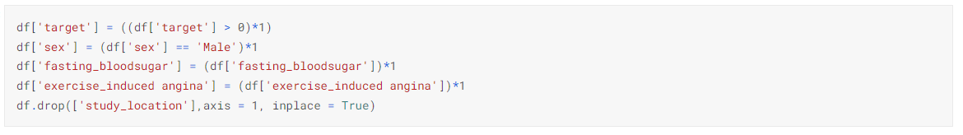
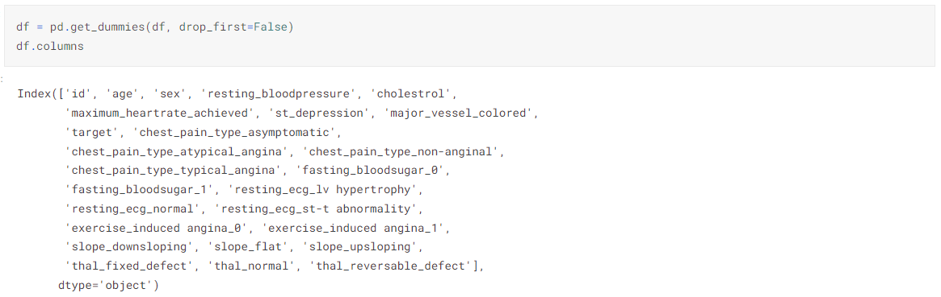
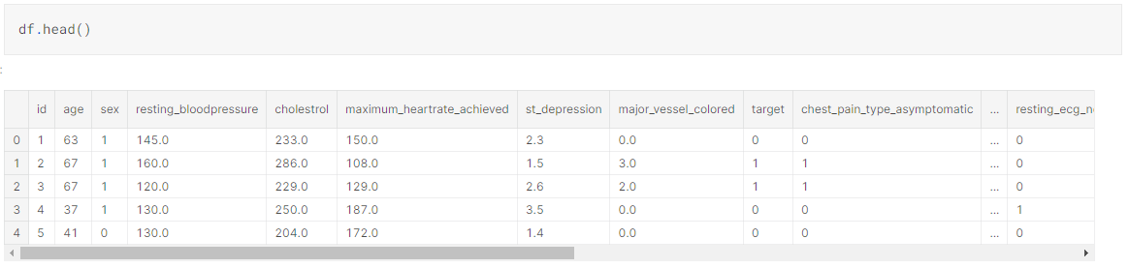
4. Data Preprocessing
like OneHotEncoding
type change: Object → Binary(integer)
Drop Columns
cannot convert to integer
not necessarily necessary
Final Dataset for making model

Slide 6
5. Model
MLP(Multi-layer Perceptron)
Multilayer perceptron (MLP) is a forward artificial neural network with multiple layers of perceptrons.
It consists of an input layer, a hidden layer, and an output layer. Each layer processes the input through the activation function
* What is a perceptron?
The sum of all products multiplied by the weight and the input value is judged by the activation function,
If the value is greater than the threshold (usually 0), the neuron (or internal function) is activated and outputs 1 as the result.
This determines the value to be 0 or 1. The resulting value is called the output value
Extra tree classifier
Extra tree classifier is a variant of the random forest model.
Extra trees increase randomness by randomly splitting each candidate feature of the forest tree.
* What is a random forest?
Random Forest ensembles multiple decision trees using boosted samples and random candidate features.
This avoids overfitting the training data and the generalization performance of the model is always higher than that of a single tree.
Notes:
mention shortly

Slide 7
5. Model
CART(Classification and Regression Tree)
Create a decision tree by starting with the entire dataset and splitting subsets of the dataset using all predictor variables to iteratively create two child nodes.
SVC(Support Vector Classification)
SVM is a supervised machine learning model used for classification. A support vector machine (SVM) is a model with constraints added to the perceptron-based model to find the most stable decision boundary.
Notes:
mention shortly

Slide 8
5. Model
GBM(Gradient Boosting Machine)
Gradient boosting is a machine learning technique used in regression and classification tasks, among others.
It gives a prediction model in the form of an ensemble of weak prediction models, which are typically decision trees.
When a decision tree is the weak learner, the resulting algorithm is called gradient-boosted trees;
it usually outperforms random forest.
Notes:
mention shortly

Slide 9
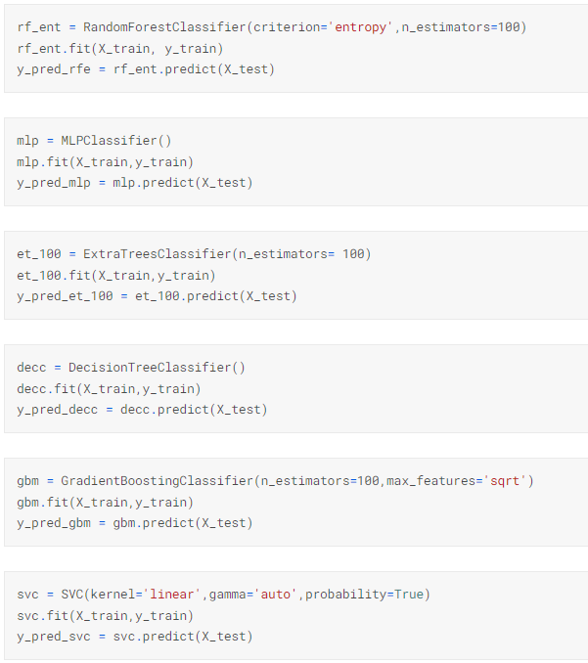
5. Model (code)
Notes:
mention shortly

Slide 10
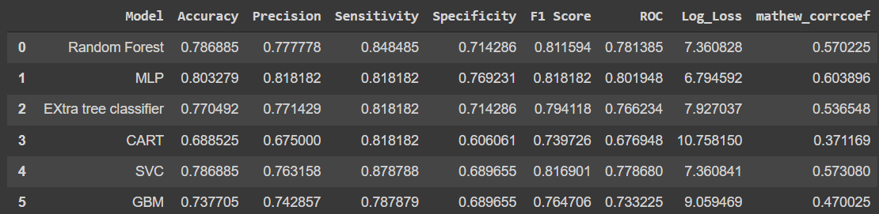
6. Result
The table below shows the results of the different models. Based on the accuracy the best model to use is MLP that had an accuracy of 81.8% otherwise based on sensitivity the best model was SVC which had sensitivity of 87.8%
Notes:
compare models

Slide 11
7. Limitations
The dataset was not extensive enough as it only contains 920 rows and 14 columns
the model will not be able to cover other heart diseases as it is geared to only detecting one heart disease.

Slide 12
8. Conclusion & future works
Conclusion
Logistic regression and MLP were the best models to use respectively based on their accuracy score which were 85% and 80%.
Future works
Some of the future work to include in this project is to train the different models on more complex data and a larger dataset. Implement this solution on a more complex model than can predict more than one heart disease.
Notes:
choose a best model & why & improve our model

Slide 13
Any Question?
Thanks

